Slide 1
Neutrinoless Double Beta Decay and Sterile Neutrinos
Yu-Feng Li (李玉峰)
中国科学院高能物理研究所
2021-05-20
“无中微子双贝塔衰变”研讨会@中山大学珠海校区

Slide 2
𝟎ν𝟐𝜷-decay
Standard Interpretation:
mediated by light massive Majorana neutrinos
Nonstandard Interpretations: sterile neutrinos and beyond
Recent reviews: 1902.04097, 1601.07512, 1411.4791, … …

Slide 3
Effective Majorana Neutrino Mass
7 out of 9 parameters of light Majorana neutrinos !
Neutrino oscillation and non-oscillation measurements contribute to the prediction of m_{𝜷𝜷} !

Slide 4
Neutrino oscillations

Slide 5
Three-neutrino mixing framework

Slide 6
Latest oscillation parameters
5 parameters: measured with rather high accuracy
4 parameters:
relevant to m_{𝜷𝜷}

Slide 7
Neutrino mass spectrum

Slide 8
Neutrino mass ordering (circa 2021)
@Nu2020
@Nu2020
SK@Nu2020
Near Future:
T2K & NOvA & SuperK
JUNO (reactors): 2022
PINGU (ORCA): 202x?
DUNE (HyperK): ~2027?

Slide 9
Neutrino mass scale from beta-decay
Future Prospect:
KATRIN: 200 meV
Systematic limit: ~100 meV
Project 8: 40 meV
2105.08533
<0.8 eV (90 C.L.)
Snowmass 2021

Slide 10
Neutrino mass scale from cosmology
PDG 2020
1903.03689
Cosmology: sum of neutrino masses
Data sets and model dependence
Current best limit: ~120 meV
Future projection → 60 meV

Slide 11
Neutrino mass scale from 𝟎ν𝟐𝜷-decay
𝟎ν𝟐𝜷-decay: effective neutrino mass limit as in 2021
An updated plot of 1411.4791

Slide 12
m_{𝜷𝜷} : Decomposition
Three different regions:
QD:
m_{1/3}>10 meV
Hierarchical:
m_{1/3}<1 meV
Cancelation:
[1, 10] meV
1505.00978

Slide 13
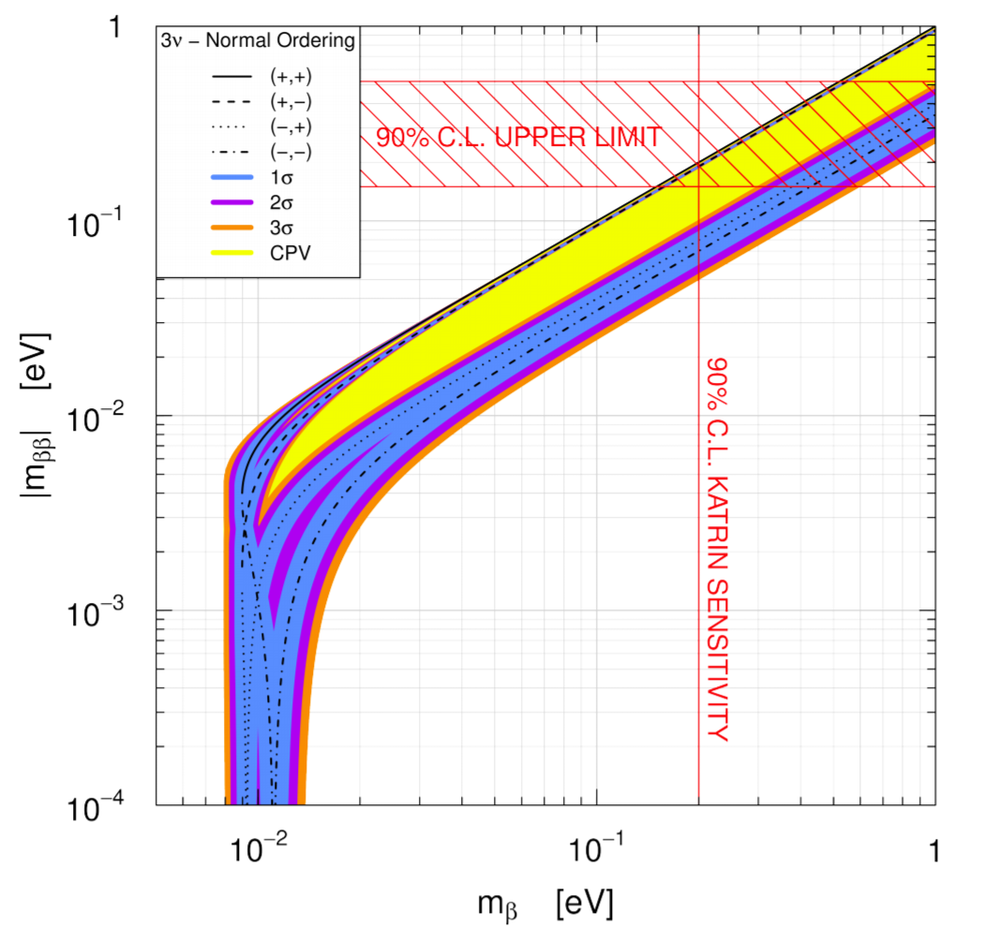
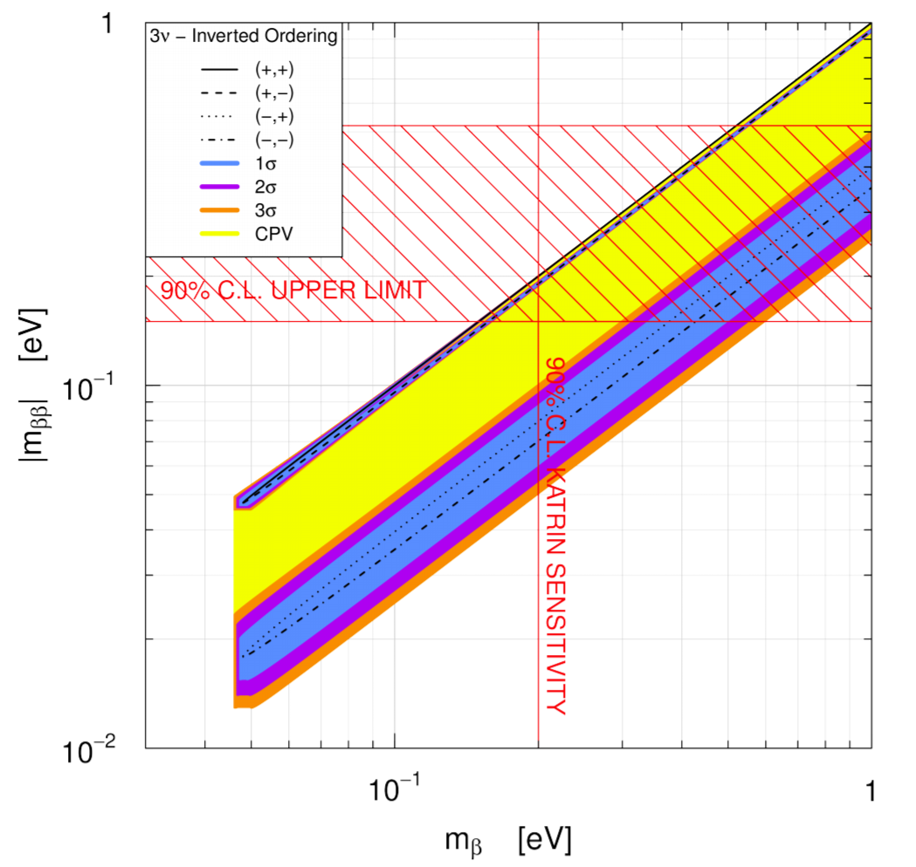
I: Quasi-Degenerate region
Extraction of the CP phase by comparing with beta decay or cosmology probe

Slide 14
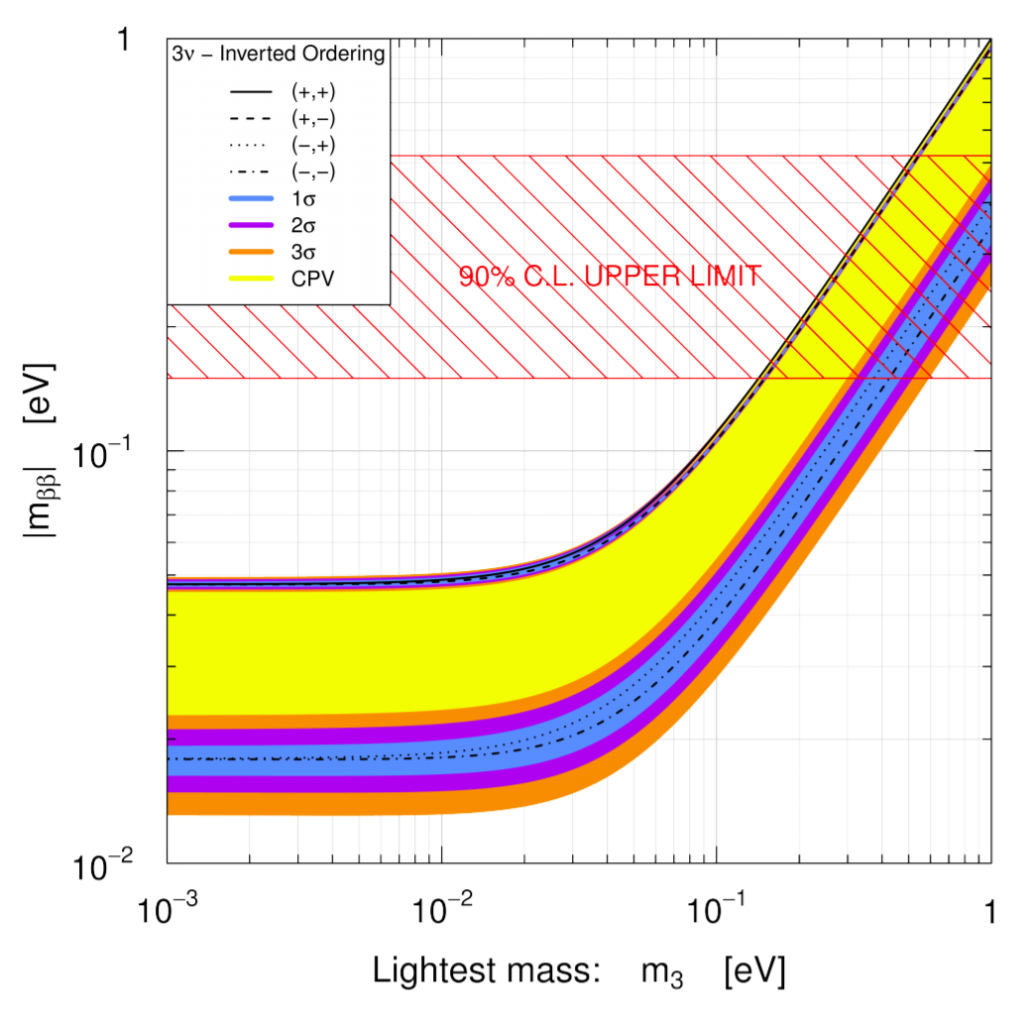
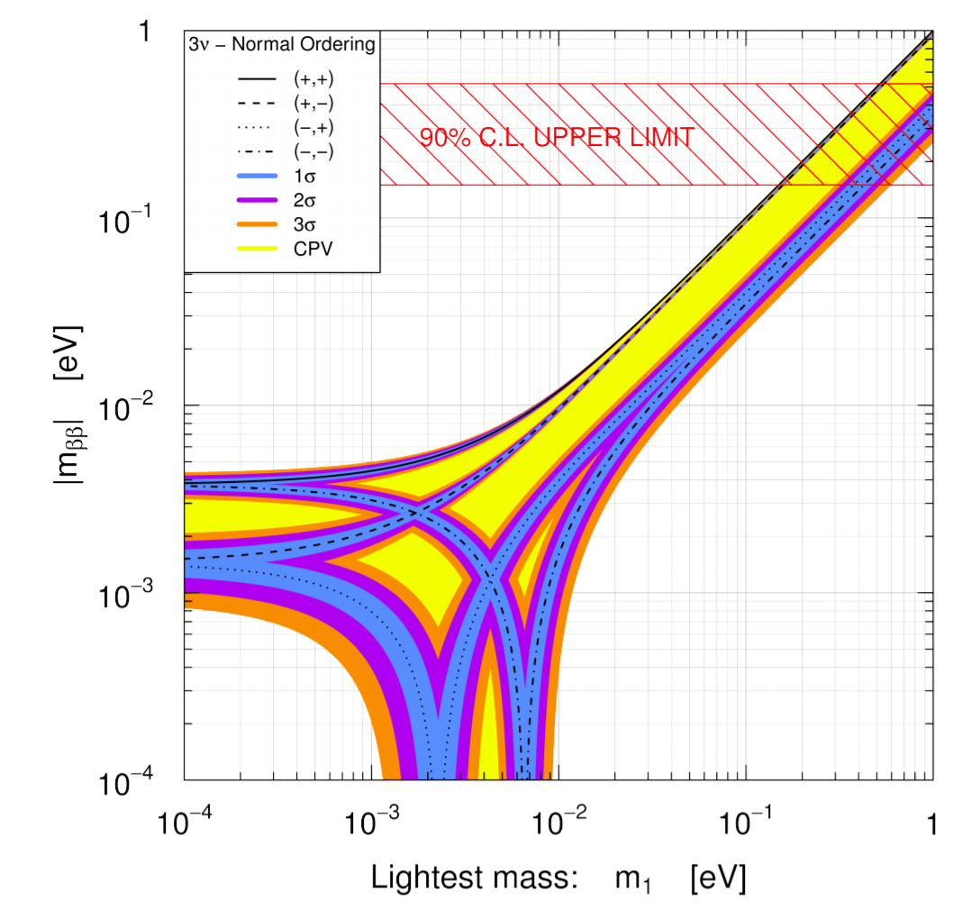
II: Hierarchical Region
Independent of the absolute neutrino masses (NO & IO)

Slide 15
III: Cancelation region
Xing & Zhao, 1612.08538: The critical threshold point is just ~1 meV !

Slide 16
Mass probe correlation
What is the interpretation if out of the standard region?

Slide 17
Short baseline oscillations: Anomalies?

Slide 18
LSND

Slide 19
MiniBooNE
Purpose: check LSND signal with different L&E, but the same L/E
~4-5σ excess in the Low energy range: unidentified backgrounds?
Future test with MicroBooNE ? Soon within this year!

Slide 20
Gallium anomaly SAGE, PRC (2006); PRC (2009); Laveder et al. (2007), etc.
Gallium Radioactive Source Experiments: GALLEX and SAGE
Test of Solar Neutrino Detection
~2.9σ deficit
Neutrino energies: ~0.8 MeV
Anomaly supported by new cross section measurement
Frekers et al., PLB 706 (2011) 134

Slide 21
Gallium anomaly: shell model calculations ?
1906.10980
Kostensalo, Suhonen, Giunti, Srivastava

Slide 22
Reactor Antineutrino Anomaly
Discrepancy between theory and measurements
~2.8σ deficit (depending on the theoretical flux uncertainty)
Nominal theoretical uncertainty from the model (Saclay+Huber) ~ 2.5%

Slide 23
Challenge I: 5 MeV bump

Slide 24
Challenge II: fuel evolution
Daya Bay
arXiv:1704.01082
arXiv:1901.01807
Reactor rates as function of the fuel fraction: A new information (slope)!
Inconsistent with model prediction at around 3σ

Slide 25
Global fits: muon disappearance

Slide 26
Appearance v.s. Disappearance: Tension

Slide 27
Future Test ?

Slide 28
𝟎ν𝟐𝜷-decay: the effective mass
Effective mass

Slide 30
Test with 𝟎ν𝟐𝜷
Huang & Zhou: 1902.03839
→can be tested in next-generation experiments!

Slide 31
Heavy sterile from seesaw ?
Different mass regions:
Low energy limit: same as light massive neutrinos
High energy limit:
Xing, 0907.3014
Contribution will be negligible if the seesaw relation is required.
Middle region:
Could be compatible when apply the seesaw relation
DLFang@Ge76
Low energy limit
Middle region
High energy limit

Slide 32
Sterile neutrinos from seesaw
Unit: eV
NO
Unit: eV
IO
Effective mass (both light and heavy neutrinos)
Degenerate case: suppression
Hierarchical case: enhancement

Slide 33
What if 0ν2𝜷 is observed?
Neutrinoless double beta decay: neutrino nature and masses!
After the discovery of 0ν2𝜷
Distinguishing Mechanisms:
Comparison of different mass probes: agreement or not ?
Other contributions: light/heavy sterile neutrinos, and more …
Decay products
individual electron energies, angular correlations, spectrum
Nuclear aspects
multiple isotopes, decay to excited states, 0νECEC,
Thank you !

Slide 35
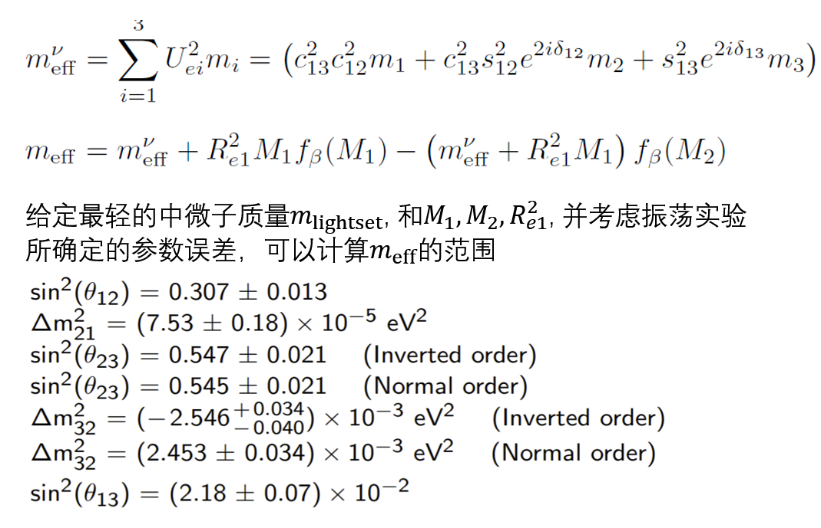

Slide 36
Oscillation Types

Slide 37
Categories of neutrino oscillations-I

Slide 38
Categories of neutrino oscillations-II

Slide 39
Categories of neutrino oscillations-III

Slide 40
Role of Precision Measurement (JUNO)
JUNO Physics Book: 1507.056131
Cao et.al, 1908.08355
Precision measurement can eliminate (almost) all the uncertainties from oscillation parameters

Slide 41
Fine structures
Cao et.al, 1908.08355
The critical threshold point could serve as the ultimate goal for 0ν2𝜷 searches.
The possibility of falling into the well is very small.
Have unique (otherwise impossible) constraints on non-oscillation parameters

Slide 42
Fixing the mass spectrum
Neutrino mass spectrum: important to understand the origin of fermion mass and mixing!

Slide 43
Implications for beta-decay and cosmology
(much) better than the projected sensitivities of future beta decay and cosmology probes!

